Slide 1


Paul Dai
July 20, 2022

Slide 2

Outline
Executive Summary
Introduction
Methodology
Results
Conclusion
Appendix

Slide 3
Executive Summary
Summary of methodologies
Data Collection: SpaceX API and Web Scraping
Data Wrangling
Exploratory Data Analysis (EDA): SQL and Data Visualization
Interactive Visual Analytics: Folium and Dashboard
Predictive Analysis: Classification
Summary of all results
EDA result
Screenshot of folium and dashboard
Predictive Analytics result

Slide 4
Introduction
Project background and context
SpaceX advertises Falcon 9 rocket launches on its website with a cost of 62 million dollars; other providers cost upward of 165 million dollars each, much of the savings is because SpaceX can reuse the first stage. Therefore if we can determine if the first stage will land, we can determine the cost of a launch. This information can be used if an alternate company wants to bid against SpaceX for a rocket launch. The goal of this project is to create a data pipeline and machine learning models to predict whether the first stage of SpaceX would land successfully or not.
Problems you want to find answers
What features will impact on the landing success rate of first stage?
What the landing success rate of first stage is predicted in our model ?
What the accuracy of our model?

Slide 5

Section 1

Slide 6
Methodology
Executive Summary
Data collection methodology:
Using SpaceX API and web scraping from Wikipedia to collect those raw data.
Perform data wrangling
We deal with the missing values and one-hot encoding is applied to our features
Perform exploratory data analysis (EDA) using visualization and SQL
Perform interactive visual analytics using Folium and Plotly Dash
Perform predictive analysis using classification models
We standardize our data and split it in to train and test dataset, and use GridSearchCVto find the best classification model to predict the landing success rate.

Slide 7
Data Collection
We collect our raw data with a series of processes:
We request the data by SpaceX API and transform the json file into data frame.
Second step, we do some necessary ETL job to clean our data.
After that, we use BeautifulSoup to scrape Wikipedia for SpaceX launch records and convert those records into data frame.

Slide 8
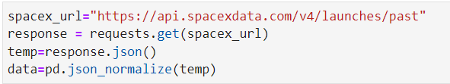
Data Collection – SpaceX API
1. Collecting the raw data by SpaceX REST calls
2. Filter the data only with ‘Falcon 9’ launch
3. Dealing with Missing Values
GitHub Repo: https://github.com/Paul60209/Space-Y/blob/main/1_Collecting%20the%20data.ipynb

Slide 9
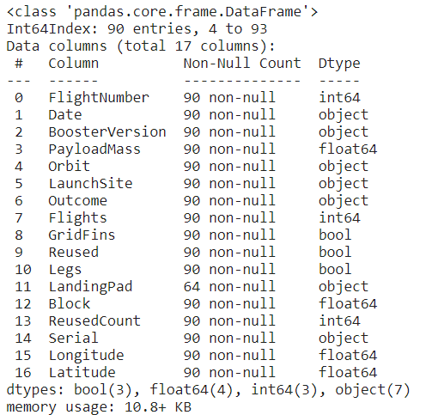
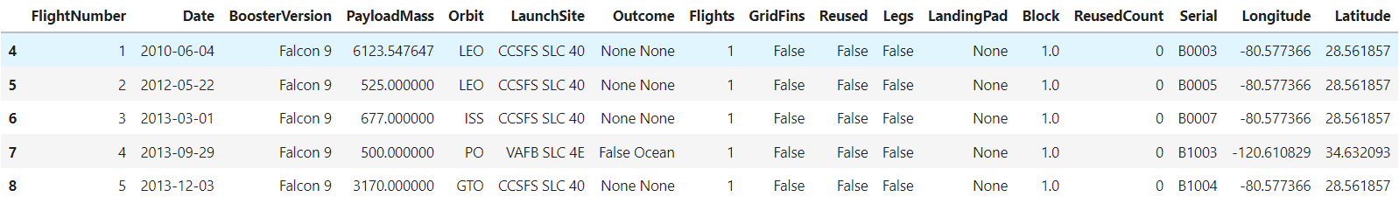
Data Collection – SpaceX API
The information of the launch data
The examples of the launch data

Slide 10
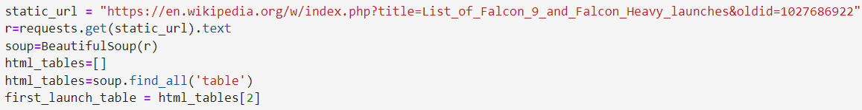
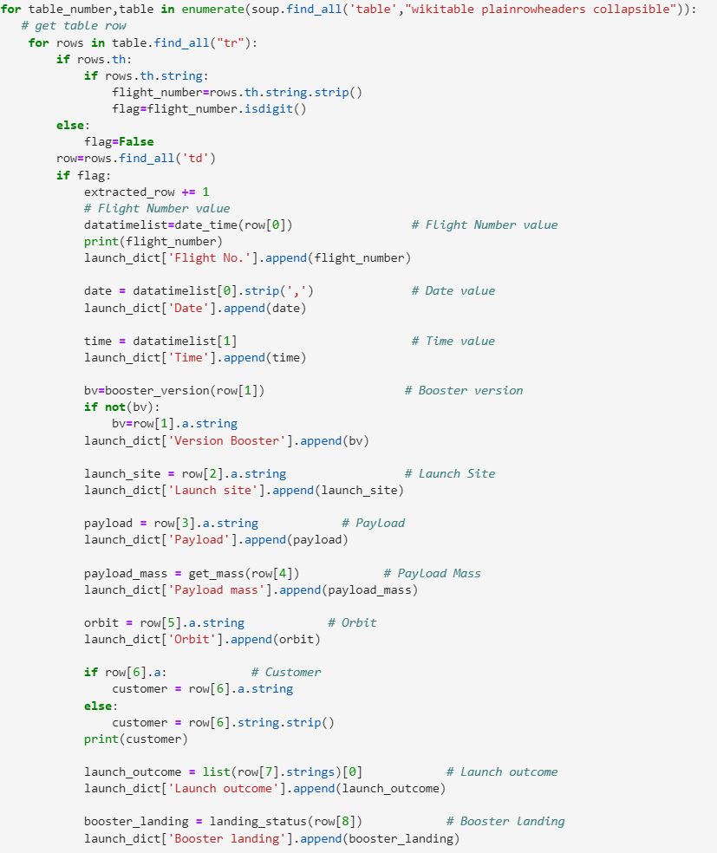
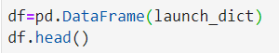
Data Collection - Scraping
1. Request Wiki and get the launch table
2. Iterate columns and extract data
3. Convert to data frame
GitHub Repo: https://github.com/Paul60209/Space-Y/blob/main/2_Web%20Scraping.ipynb

Slide 11
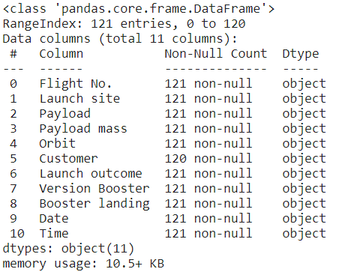
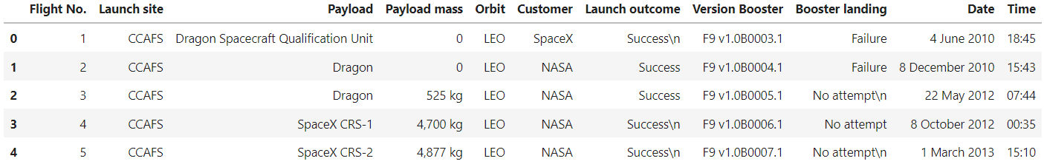
Data Collection – Scraping Result
The information of the scraping result
The examples of the scraping result
GitHub Repo: https://github.com/Paul60209/Space-Y/blob/main/2_Web%20Scraping.ipynb

Slide 12
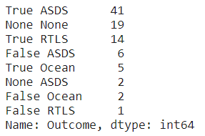
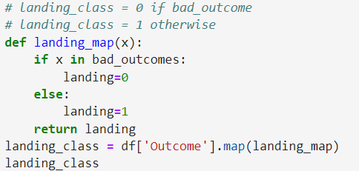
02
03
Data Wrangling
Efficiency
1
Explore the mission outcomes
3
Insert the landing outcome label to the dataset
2
Define the bad outcomes
GitHub Repo: https://github.com/Paul60209/Space-Y/blob/main/3_Data%20wrangling.ipynb

Slide 13
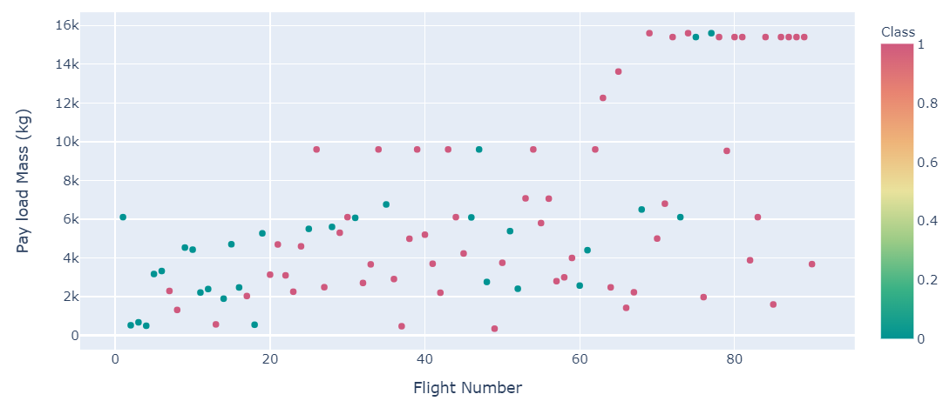
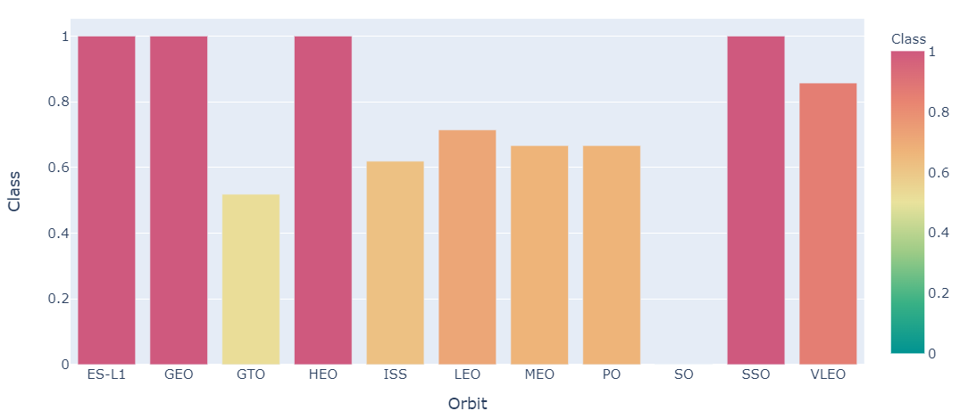
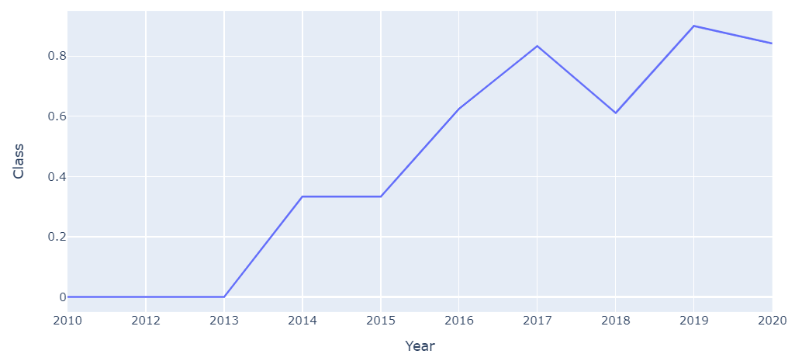
EDA with Data Visualization
Before creating machine learning model, we used data visualization tools (plotly express) to do some EDA and tries to understand our features such as Orbit, Launch Site, Payload Mass and Launch Result.
GitHub Repo: https://github.com/Paul60209/Space-Y/blob/main/5_Exploring%20and%20Preparing%20Data.ipynb

Slide 14
EDA with SQL
As we learned the relationship between our features, we could apply SQL to do some descriptive statistics:
Display the names of the unique launch sites in the space mission
Display average payload mass carried by booster version F9 v1.1
List the date when the first successfully landing outcome in ground pad was achieved.
List the total number of successful and failure mission outcomes
List the names of the booster versions which have carried the maximum payload mass.
Rank the count of successful landing outcomes between the date 04-06-2010 and 20-03-2017
GitHub Repo: https://github.com/Paul60209/Space-Y/blob/main/4_EDA%20with%20SQL.ipynb

Slide 15
Build an Interactive Map with Folium
As SpaceX has launched rocket in different launch site, we were thinking if the launch location will impact on landing result. We use Folium to put our data on the map:
We marked each launch site on the map with
We marked launch times on each launch site with
We added landing result on the tooltip of each launch site with
We calculated the distance and drew a line between a launch site to its proximities with
GitHub Repo: https://github.com/Paul60209/Space-Y/blob/main/6_Locations%20Analysis%20with%20Folium.ipynb

Slide 16
Build a Dashboard with Plotly Dash
To help our shareholders to understand our features easily, we used plotly dash to build a interactive dashboard, here is the following steps:
First, we import our data as data frame.
Then, we used html() to create the layout of the dashboard.
We created interactive components (e.g. filters, figures) by using dcc package.
Next, we used plotly express to draw each charts.
Finally, the callback function would help us to communicate the parameters between dcc and our charts.
GitHub Repo: https://github.com/Paul60209/Space-Y/blob/main/7_spaceX_dash_app.py

Slide 17
Predictive Analysis (Classification)
After we done our EDA, we could start to build our machine learning model and do our predictive analysis with below processes:
Load our cleaned data as data frame.
Check there is non-missing value and our features are already been encoded in one-hot encoding.
Standardize our features to prevent features with wider ranges from dominating the distance metric.
Split our dataset into two parts: train data and test data.
Create several classification models and use GridSearchCV to find the best hyperparameters.
Evaluate our models accuracy and determine our best model.
GitHub Repo: https://github.com/Paul60209/Space-Y/blob/main/8_Machine%20Learning%20Prediction.ipynb

Slide 18
Results
Exploratory data analysis results
Interactive analytics demo in screenshots
Predictive analysis results

Slide 19

Section 2

Slide 20
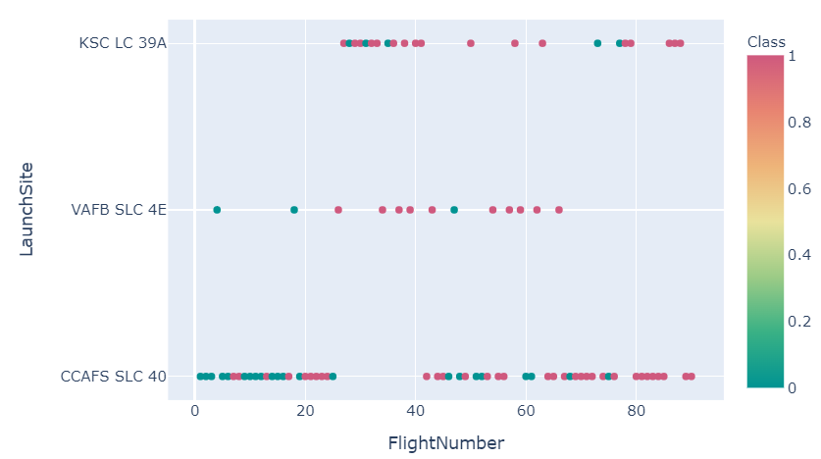
Flight Number vs. Launch Site
The right scatter plot shows there is a significant positive relationship between the success rate and the flight number.
Because the flight numbers are ordering by time, which means the landing success rate in SpaceX is improving.
GitHub Repo: https://github.com/Paul60209/Space-Y/blob/main/5_Exploring%20and%20Preparing%20Data.ipynb

Slide 21
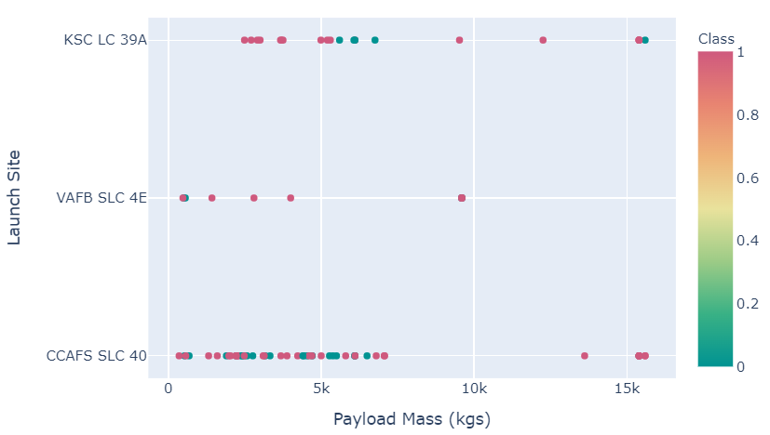
Payload vs. Launch Site
The plot seems has greater success rate when is has higher payload in each launch site.
If we focus on the launch site ‘CCAFS SLC 40’, we could see it has 100% success rate when payload over 10k(kgs).
GitHub Repo: https://github.com/Paul60209/Space-Y/blob/main/5_Exploring%20and%20Preparing%20Data.ipynb

Slide 22
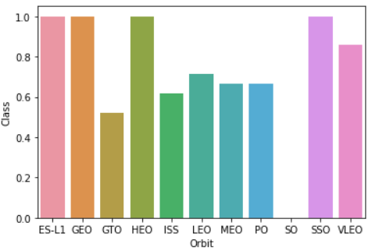
Success Rate vs. Orbit Type
ES-LI, GEO, HEO and SSO both have 100% success rate.
But the SO has 0% success rate (They only launched 1 time in SO orbit. ).
GitHub Repo: https://github.com/Paul60209/Space-Y/blob/main/5_Exploring%20and%20Preparing%20Data.ipynb

Slide 23
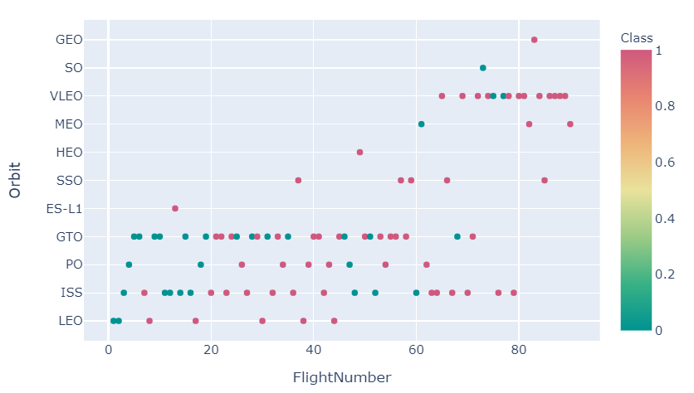
Flight Number vs. Orbit Type
The left figure shows Flight Number vs. Orbit Type. It’s hard to find significant relationship between flight number orbit type.
GitHub Repo: https://github.com/Paul60209/Space-Y/blob/main/5_Exploring%20and%20Preparing%20Data.ipynb

Slide 24
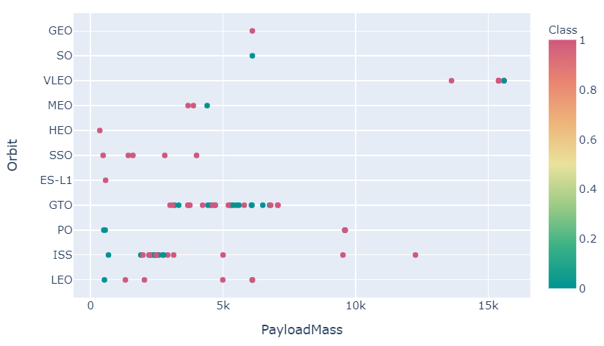
Payload vs. Orbit Type
With heavy payloads the successful landing or positive landing rate are more for PO, LEO and ISS.
However for GTO we cannot distinguish this well as both positive landing rate and negative landing(unsuccessful mission) are both there here.
GitHub Repo: https://github.com/Paul60209/Space-Y/blob/main/5_Exploring%20and%20Preparing%20Data.ipynb

Slide 25
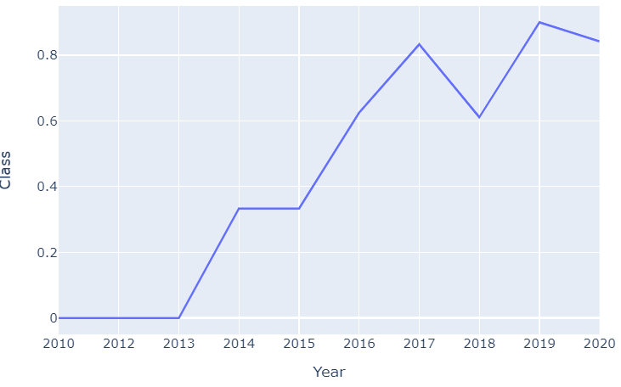
Launch Success Yearly Trend
It’s easy to observe that the success rate since 2013 kept increasing till 2020
GitHub Repo: https://github.com/Paul60209/Space-Y/blob/main/5_Exploring%20and%20Preparing%20Data.ipynb

Slide 26
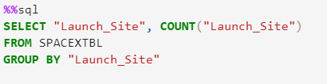
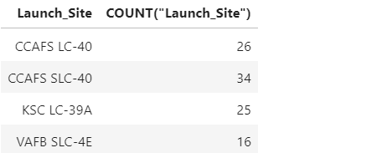
All Launch Site Names
We could use ‘DISTINCT’ or ‘GROUP BY’ keyword in SQL to find the names of the unique launch sites.
In this time we used ‘GROUP BY’ with ‘COUNT’, it would show how many times launched in each site additionally.
GitHub Repo: https://github.com/Paul60209/Space-Y/blob/main/4_EDA%20with%20SQL.ipynb

Slide 27
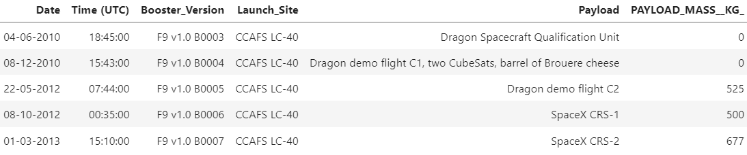
Launch Site Names Begin with 'CCA'
We use ‘WHERE’ and ‘LIKE’ to find the data which launch site start with ‘CAA’.
And ‘LIMIT’ keyword could help us to control how many rows of data we select.
GitHub Repo: https://github.com/Paul60209/Space-Y/blob/main/4_EDA%20with%20SQL.ipynb

Slide 28
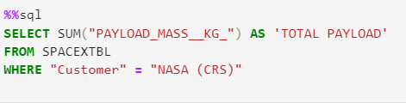
Total Payload Mass
The ‘SUM()’ function could add up chose column.
Use ‘AS’ to give the calculated column a alias.
GitHub Repo: https://github.com/Paul60209/Space-Y/blob/main/4_EDA%20with%20SQL.ipynb

Slide 29
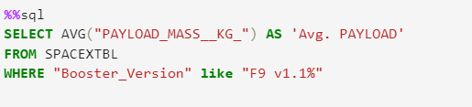
Average Payload Mass by F9 v1.1
The ‘AVG()’ function could get the mean of the chose column.
Use ‘AS’ to give the calculated column a alias.
GitHub Repo: https://github.com/Paul60209/Space-Y/blob/main/4_EDA%20with%20SQL.ipynb

Slide 30
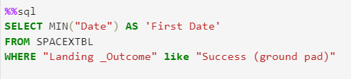

First Successful Ground Landing Date
We used ‘MIN()’ function to find the first successful date, and the date is Jan. 5th 2017.
GitHub Repo: https://github.com/Paul60209/Space-Y/blob/main/4_EDA%20with%20SQL.ipynb

Slide 31
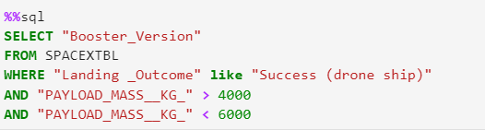
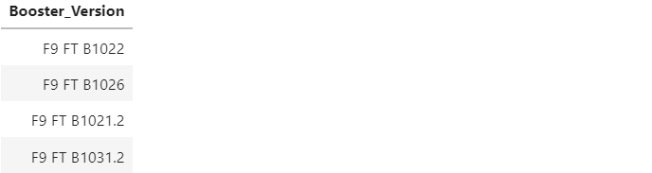
Successful Drone Ship Landing with Payload between 4000 and 6000
We use ‘WHERE’ to find the results which is matched our criteria.
When we have multiple criteria, we could use ‘AND’, ‘OR’ to connect our criteria in different logic.
GitHub Repo: https://github.com/Paul60209/Space-Y/blob/main/4_EDA%20with%20SQL.ipynb

Slide 32
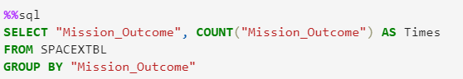
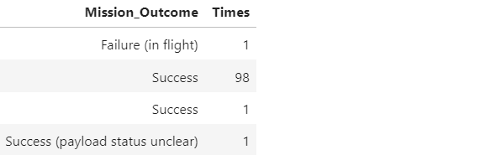
Total Number of Successful and Failure Mission Outcomes
We could use ‘COUNT()’ function to find Number of Outcome.
Then use ‘GROUP BY’ to aggregate Outcome into sole type of outcome.
GitHub Repo: https://github.com/Paul60209/Space-Y/blob/main/4_EDA%20with%20SQL.ipynb

Slide 33
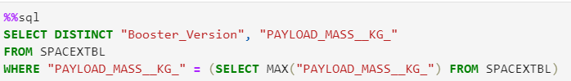
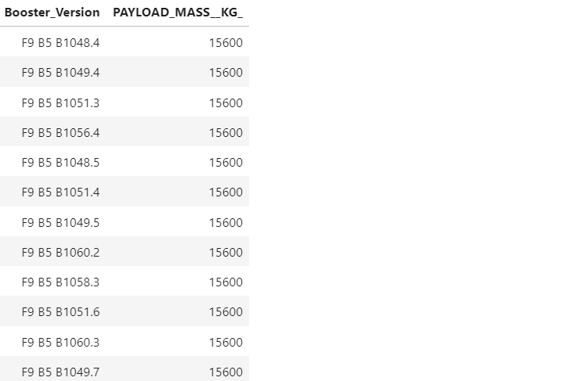
Boosters Carried Maximum Payload
We use ‘subquery’ skill to find the max of payload first.
We select our data again and insert the subquery in our WHERE clause.
GitHub Repo: https://github.com/Paul60209/Space-Y/blob/main/4_EDA%20with%20SQL.ipynb

Slide 34
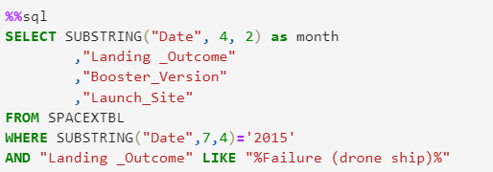
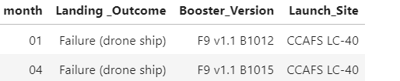
2015 Launch Records
First step, we use ‘SUBSTRING’ to get Month from Date.
Find the Year in 2015 by using ‘SUBSTRING’ again.
GitHub Repo: https://github.com/Paul60209/Space-Y/blob/main/4_EDA%20with%20SQL.ipynb

Slide 35
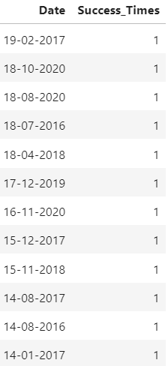
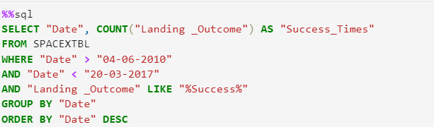
Rank Landing Outcomes Between 2010-06-04 and 2017-03-20
We use ‘GROUP BY’ to aggregate the Date data, and ‘ORDER BY’, ‘DESC’ to show result in descending order.
GitHub Repo: https://github.com/Paul60209/Space-Y/blob/main/8_Machine%20Learning%20Prediction.ipynb

Slide 36

Section 3

Slide 37
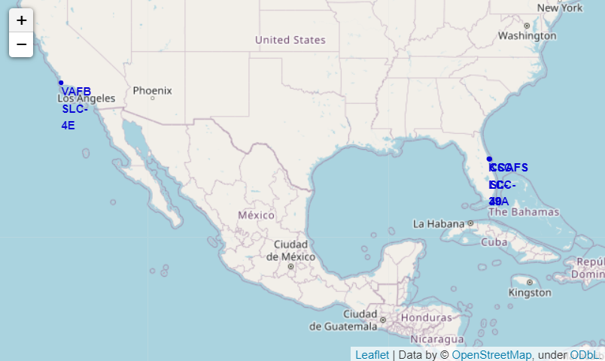
All launch sites in global map
All SpaceX launch sites are in Florida and California in USA.
GitHub Repo: https://github.com/Paul60209/Space-Y/blob/main/6_Locations%20Analysis%20with%20Folium.ipynb
Notes:
Replace <Folium map screenshot 1> title with an appropriate title
Explore the generated folium map and make a proper screenshot to include all launch sites’ location markers on a global map
Explain the important elements and findings on the screenshot

Slide 38
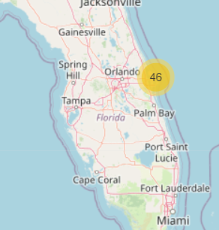
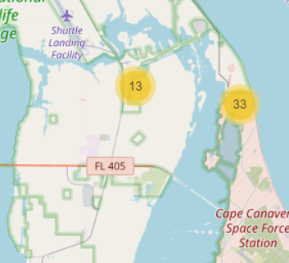
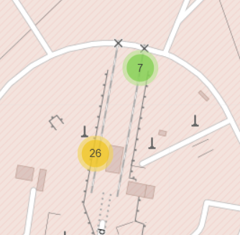
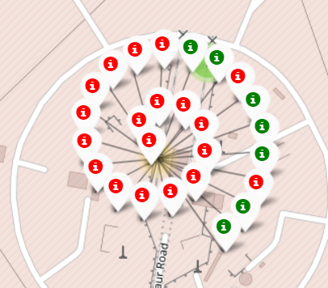
The success/failed launches for each
The number on the map are launch times and when we zoom in closer, the folium will separate the number in to two part.
If we click on the number, it would show the “i” icon in green and red, which means success or failed landing.
GitHub Repo: https://github.com/Paul60209/Space-Y/blob/main/6_Locations%20Analysis%20with%20Folium.ipynb

Slide 39
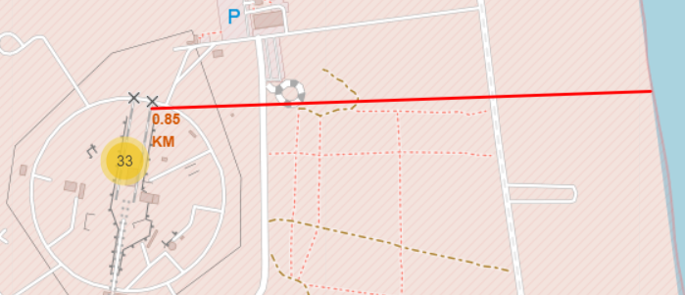
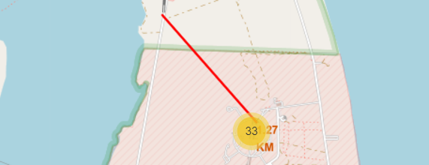
Launch Sites to its proximities
We also calculate the distances from launch site to its proximities(e.g. sea, railway, highway…etc)
GitHub Repo: https://github.com/Paul60209/Space-Y/blob/main/6_Locations%20Analysis%20with%20Folium.ipynb

Slide 40

Section 4

Slide 41
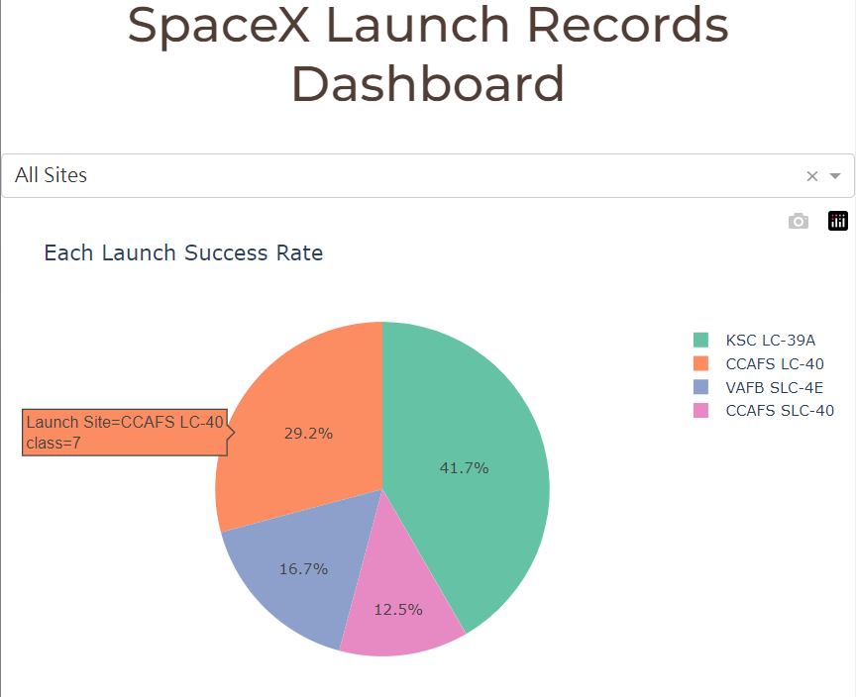
Launch Success Rate
The filter’s default value is ‘All sites’, it will shows the landing success rate of first stage in each launch site.
GitHub Repo: https://github.com/Paul60209/Space-Y/blob/main/7_spaceX_dash_app.py

Slide 42
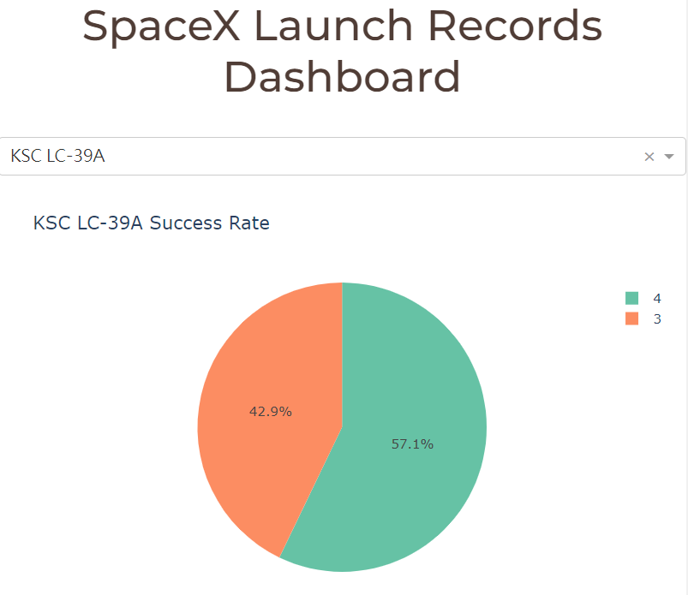
Success rate of specific launch site
When you choose a launch site (e.g. KSC KC-39A), it will shows how many times success/failed landing in the launch site.
GitHub Repo: https://github.com/Paul60209/Space-Y/blob/main/7_spaceX_dash_app.py

Slide 43
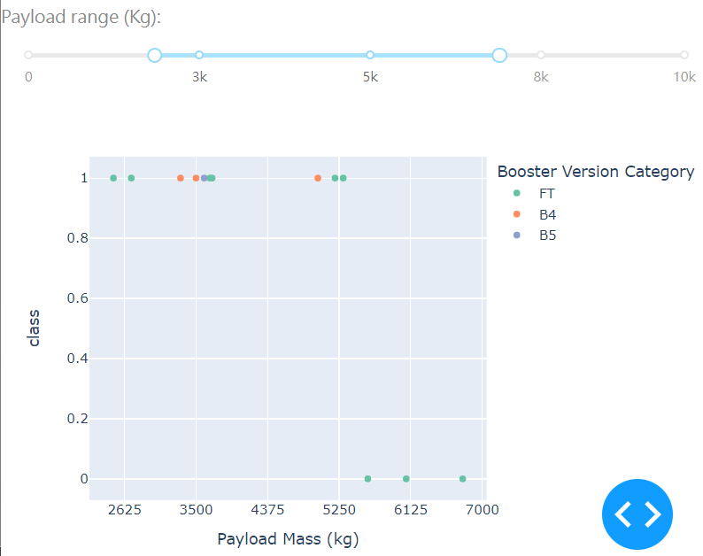
Relationship between payload and outcome
The figure shows the landing outcome in different payload mass, class=1 means success and class=0 means failed.
The above scope-bar could choose the specific range of payload mass.
GitHub Repo: https://github.com/Paul60209/Space-Y/blob/main/7_spaceX_dash_app.py
Notes:
https://github.com/Paul60209/Space-Y/blob/main/7_spaceX_dash_app.py

Slide 44

Section 5

Slide 45
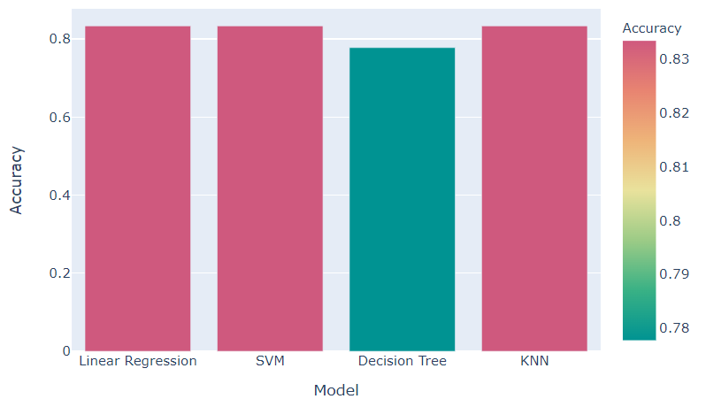
Classification Accuracy
The accuracies of Linear Regression, SVM and KNN are 83%, but the accuracy of decision tree is only 77%
GitHub Repo: https://github.com/Paul60209/Space-Y/blob/main/8_Machine%20Learning%20Prediction.ipynb
Notes:
lr_acc, svm_acc, tree_acc, knn_acc

Slide 46
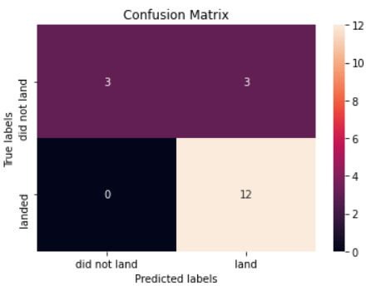
Confusion Matrix of linear regression
Recall Rate/Sensitivity(召回率)=TP/(TP+FN)=100%
Specificity=TN/(FP+TN)=50%
Precision(準確率)=TP/(TP+FP)=80%
Accuracy(正確率)=(TP+TN)/(P+N)=83%
True Negative
(TN)
False Positive
(FP)
False Negative
(FN)
True Positive
(TP)
GitHub Repo: https://github.com/Paul60209/Space-Y/blob/main/8_Machine%20Learning%20Prediction.ipynb

Slide 47
Confusion Matrix of SVM
Recall Rate/Sensitivity(召回率)=TP/(TP+FN)=100%
Specificity=TN/(FP+TN)=50%
Precision(準確率)=TP/(TP+FP)=80%
Accuracy(正確率)=(TP+TN)/(P+N)=83%
True Negative
(TN)
False Positive
(FP)
False Negative
(FN)
True Positive
(TP)
GitHub Repo: https://github.com/Paul60209/Space-Y/blob/main/8_Machine%20Learning%20Prediction.ipynb

Slide 48
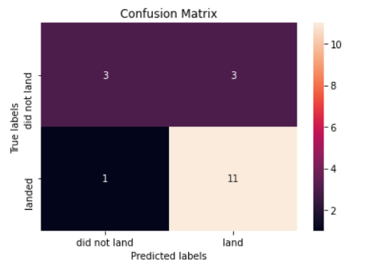
Confusion Matrix of decision tree
Recall Rate/Sensitivity(召回率)=TP/(TP+FN)=91.6%
Specificity=TN/(FP+TN)=50%
Precision(準確率)=TP/(TP+FP)=78.6%
Accuracy(正確率)=(TP+TN)/(P+N)=77.8%
True Negative
(TN)
False Positive
(FP)
False Negative
(FN)
True Positive
(TP)
GitHub Repo: https://github.com/Paul60209/Space-Y/blob/main/8_Machine%20Learning%20Prediction.ipynb

Slide 49
Confusion Matrix of KNN
Recall Rate/Sensitivity(召回率)=TP/(TP+FN)=100%
Specificity=TN/(FP+TN)=50%
Precision(準確率)=TP/(TP+FP)=80%
Accuracy(正確率)=(TP+TN)/(P+N)=83%
True Negative
(TN)
False Positive
(FP)
False Negative
(FN)
True Positive
(TP)
GitHub Repo: https://github.com/Paul60209/Space-Y/blob/main/8_Machine%20Learning%20Prediction.ipynb

Slide 50
Conclusions
We found site with highest score which is KSC LC-39A
The payload 0~5,000 kgs is more diverse than 6,000~10,000 kgs
The landing success rate of first stage was increasing in 2013 to 2020.
The Linear Regression, SVM and KNN are suitable model for this prediction.

Slide 51
Appendix
All data, codes, directions, charts and figure could be found on my GitHub:
https://github.com/Paul60209/Space-Y

Slide 52


